Slide 1
Actual idea
Name:
Fieldsync (no)
something

Slide 2
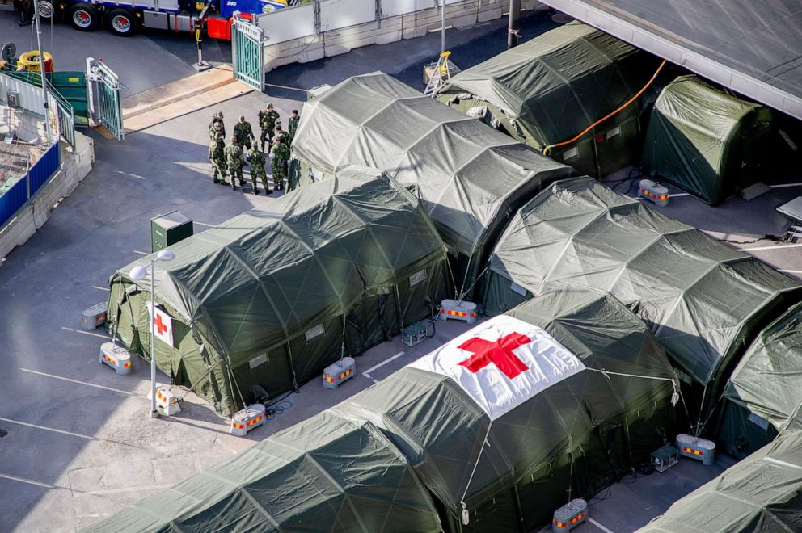
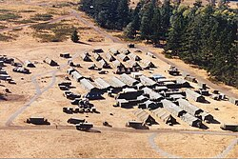
https://en.wikipedia.org/wiki/Field_hospital

Slide 3
Stakeholder analysis
main target stakeholder: military medical units
3 different levels of military medical units:
echelon 1 -> triage + first aid on injured soldiers, manage evacuation priorities
echelon 2 -> mobile operating rooms and surgery on transport
echelon 3 -> field hospitals/medical centers in battlefield, food/blood/water/resource supply management
echelon 4 -> surgical care outside battlefield
Echelon 5 -> fixed, permanent hospitals for long term recovery
https://wikem.org/wiki/Military_emergency_medicine

Slide 4
Field hospitals
targeting: echelon 3, field hospitals
not a main hospital, closer to battlefield
relatively mobile unit
setup with tents etc.
why are field hospitals critical?
most comprehensive medical support within battlefield
middleground between forward units and main hospitals
need to manage mobility vs equipment & stocks
make the most decisions involving who to and not to save for combat optimization

Slide 5
Overall idea
Application for assisting operators of field hospitals
Key features
  Medical record manager (electronic health record)
  Announcements
  Inventory system
  HQ Web app dashboard showing everything
  Authentication + hash chain based
Selling points
  Secure by design – SEC
  Offline operation – OFF
  Local communication (mesh network) – LC
  Online sync – ON

Slide 6
Medical record manager
Triage
  Registering patients with unique IDs, arrival time, description, and priority OFF
  Recording/updating of clinical observations/notes OFF
  Sharing of all this data within cluster LC (hopping occurs and all devices in cluster receive the data via BLE)
  Any device with internet access will sync with the HQ ON
  Patients can also be transferred between clusters ON
Diagnosis
  Storage of diagnosis and diagnostic data in HQ ON
Treatment
  Retrieval of previous medical information from HQ ON
  Storage of treatment plan in HQ ON

Slide 7
Announcements
Information dissemination (Announcements)
  Intra cluster LC (hopping occurs and all devices within cluster receive data via BLE)
  Cluster to HQ and vice versa ON (Any device with internet access will sync to the cloud)

Slide 8
Inventory
Inventory
  Per station (i.e. per operator) usage tracking OFF
  Per cluster usage tracking LC (Same hopping to spread inventory information)
  Inventory information send to cloud HQ when internet access is available ON
  Clusters can request other clusters for required inventory/equipment ON
Usage forecast
  Inventory statistics in HQ web app

Slide 9
Network operations
OFF: offline features
  Operates regardless of network status
LC: local communication
  Communicate with physically nearby devices over BLE
  Follows mesh network topology
  Similar to meshtastic but with BLE
ON: online features
  Mainly cloud sync stuff

Slide 10
Technical overview
Frontend: Flutter (targeting android for now, the HQ will be a web app)
Bluetooth: Kotlin BLE API
  Mesh network allows ‘hopping’ such that requests reach the nearest internet connected device if possible, allowing local sync even if network is unavailable
Offline storage: SQLite for local storage
Backend: FastAPI on Python for synchronising with HQ
HQ Database: PostgreSQL
Conflict Detection: Any conflicting requests will be brought up for human overview

Slide 11
Standardised terms
Cluster: a small localised region of operation (e.g. within 2-3 medical tents)
  Also defined by the nodes connected in a mesh network
Mesh network: connected by the Bluetooth link

Slide 12
qna
hehe

Slide 13
hehe
Time sync thingy
Patient medical records how

